Slide 1
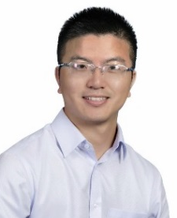
北京大学软物质科学系列报告 84
Synthetic Biology Approaches toward
New Materials
Prof. Fei Sun
Department of Chemical and Biological Engineering
Hong Kong University of Science and Technology
2019年07月03日（周三）下午 15:30 化学学院 A205

